Slide 1
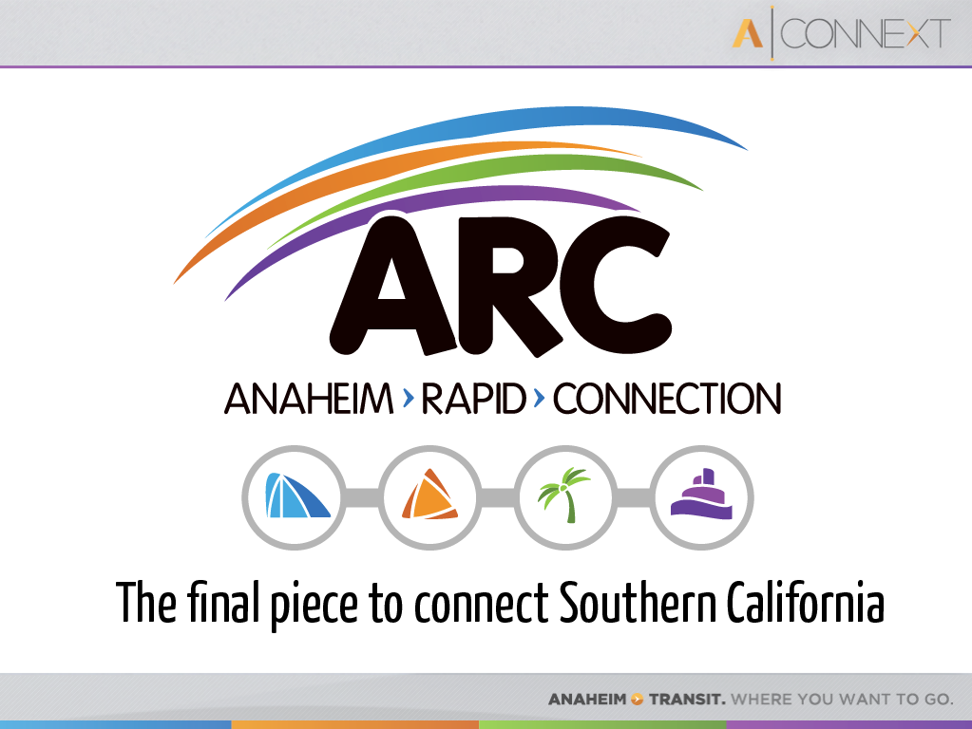


Slide 2
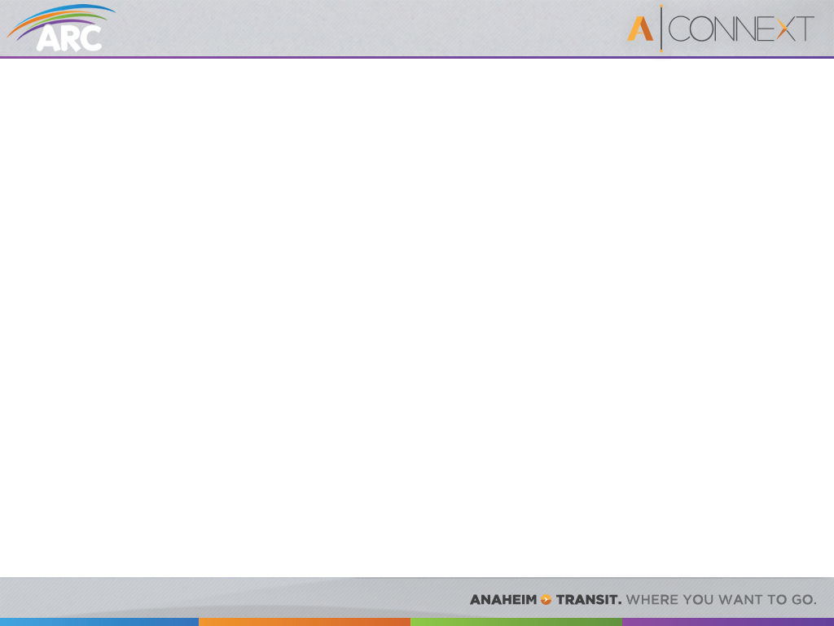
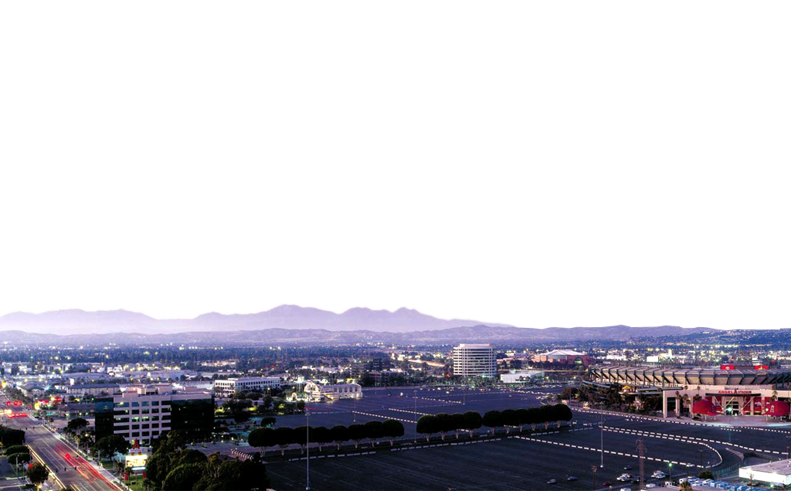
Study Area
Approximately 73,000 employees
Home for 25,000 residents
Approximately 20 million visitors annually
All within 5 square miles and at the doorstep of ARTIC

Slide 3
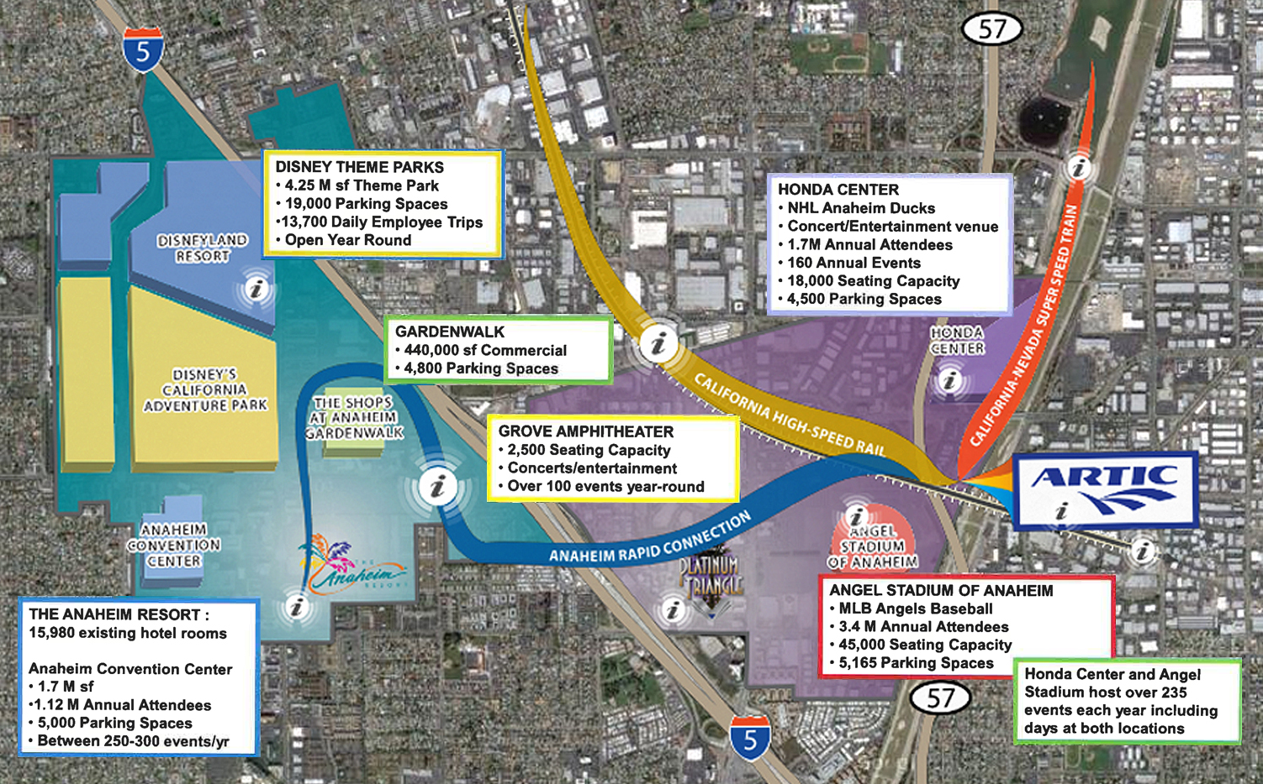
Key Destinations
CITY NATIONAL GROVE OF ANAHEIM
2,500 Seating Capacity
Concerts/entertainment
Over 100 events year-round

Slide 4
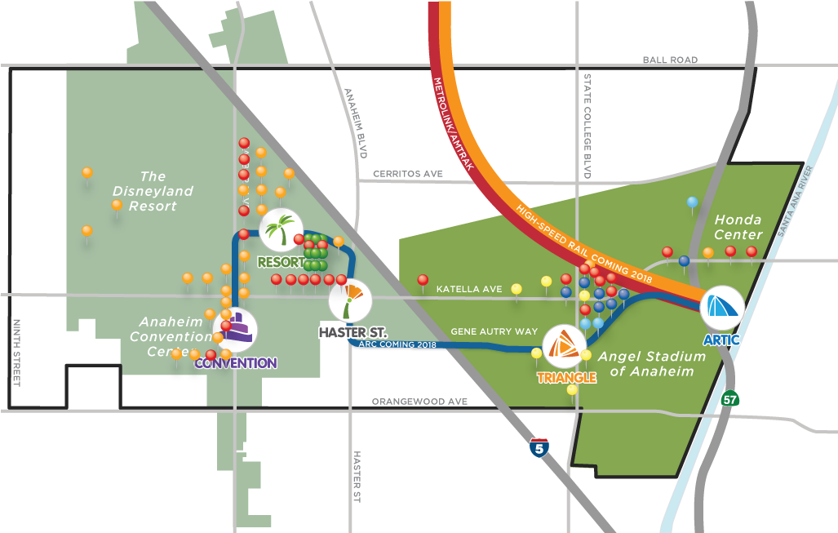
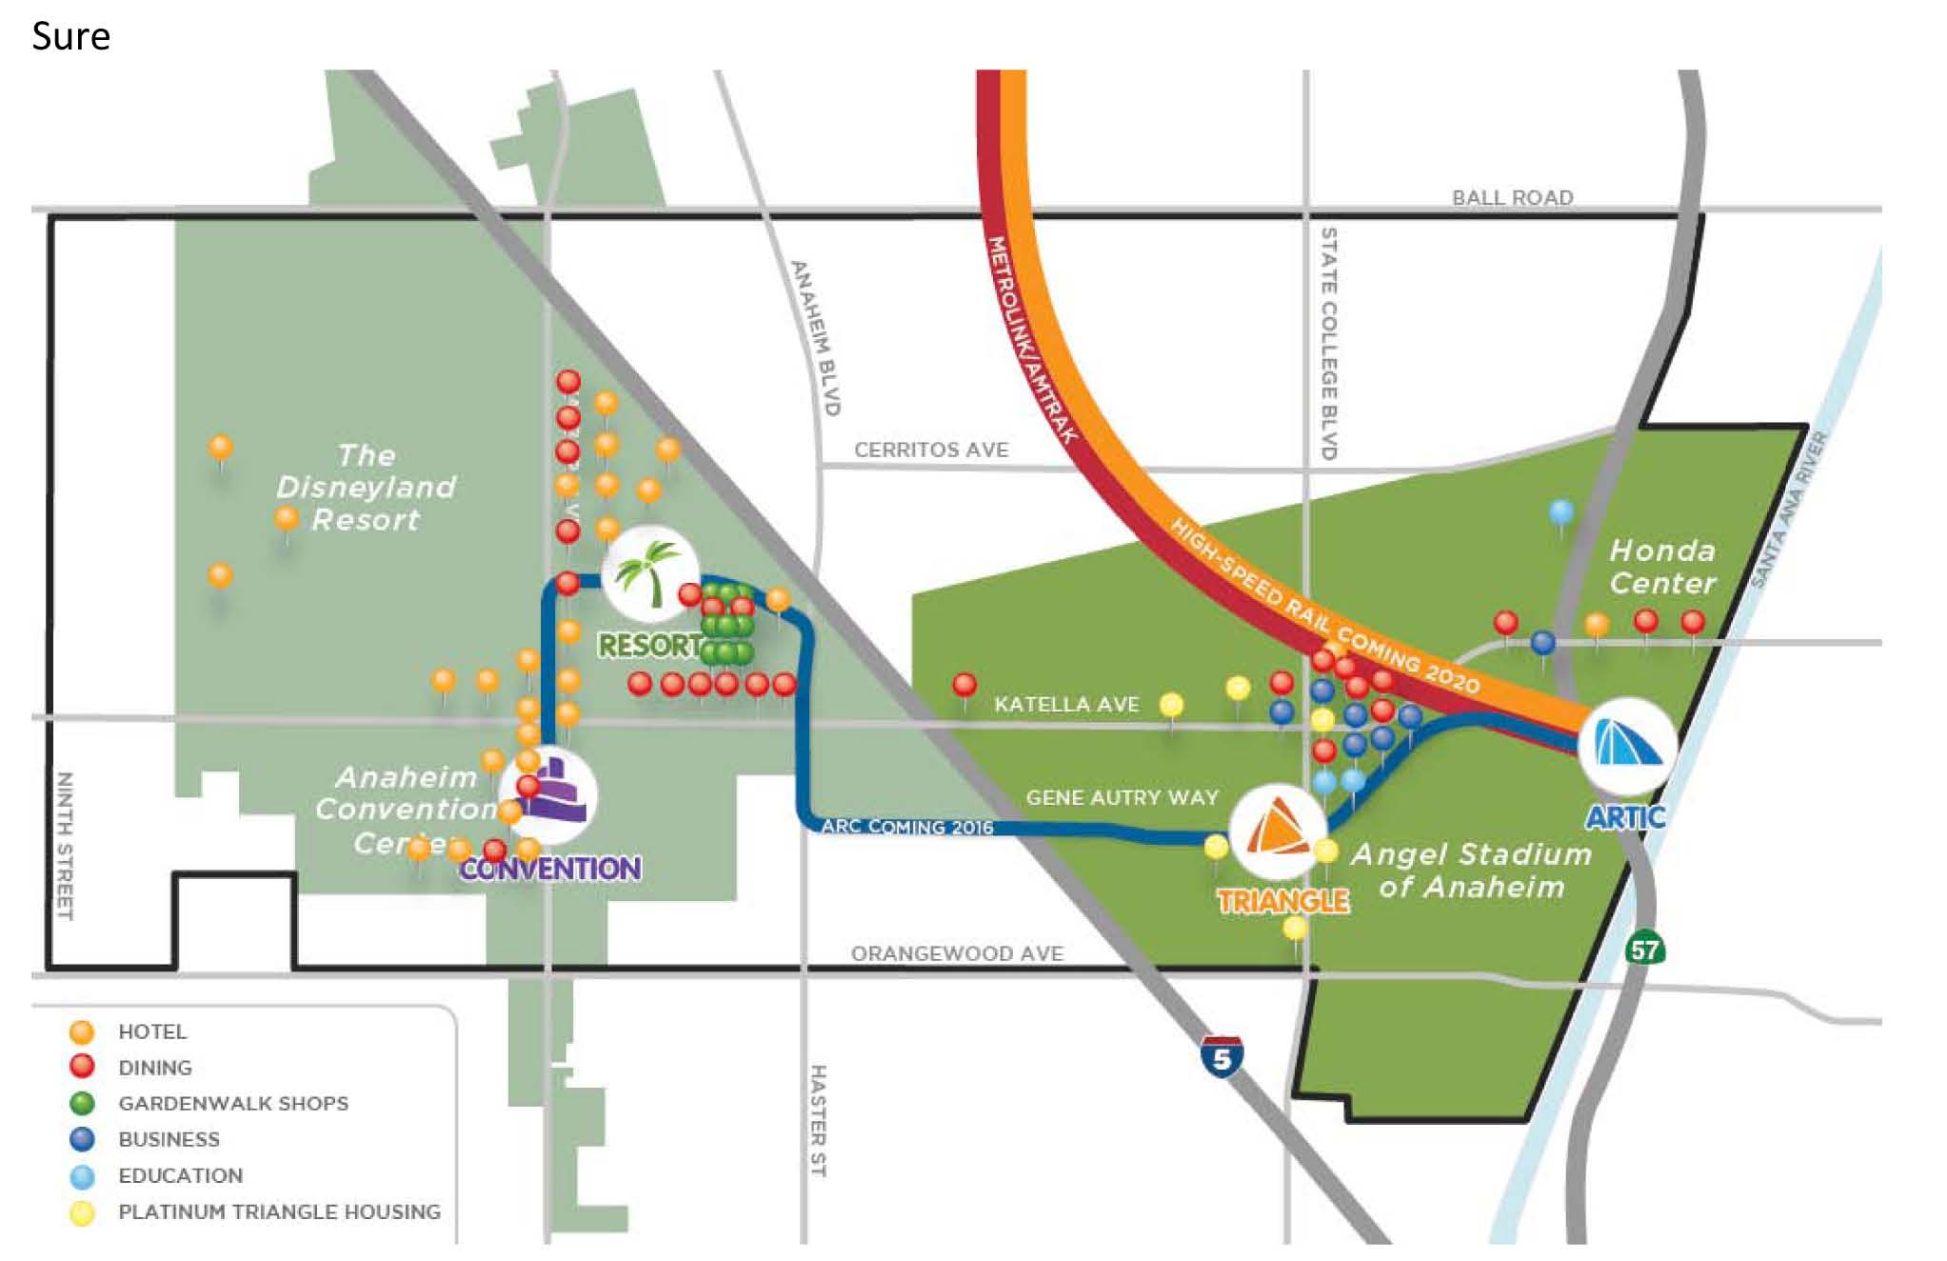
Alignment – Elevated Fixed Guideway
Represents one of the alignments under consideration

Slide 5
Benefits
ARC will provide a cleaner, safer, and more efficient way to enjoy Anaheim by enabling economic development, providing mobility opportunities for the community and supporting livability
Greatly improves last mile connection to regional transit for workers, residents and visitors, as well as internal circulation, making transit a viable option for many
  Saves travel time
  Improves reliability
  Increases transit ridership
Enables development of a new and highly livable urban place – dense, mixed use, and walkable – built around transit, where no car is needed
  City vision and plans are in place
  City working on implementation strategies
  ARC is vital to creation of this new urban place
Notes:
Presenter Natalie Meeks
Creates an efficient effective transit system that connect directly to the backbone of Orange County’s growing regional transit system including Metrolink and Amtrak as well as future rail systems.
Provides the foundation for public transit within the urban community

Slide 6
Alternatives Screening Process
  Starting Point: “Long List” of alternatives and technologies
12 potential fixed-guideway alignments
9 technologies
  Developed initial screening framework (based on Purpose & Need / Goals & Objectives)
  Applied screening to reach preliminary “Short List”
  “Short List” studied further in Step 2 – Alternative Analysis (AA)/
  Environmental Impact Statement/Environmental Impact Report through advanced conceptual engineering
  Perform engineering feasibility analysis

Slide 7
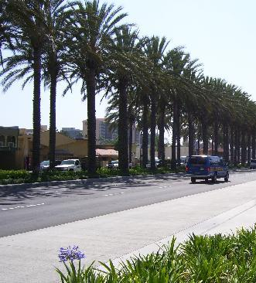
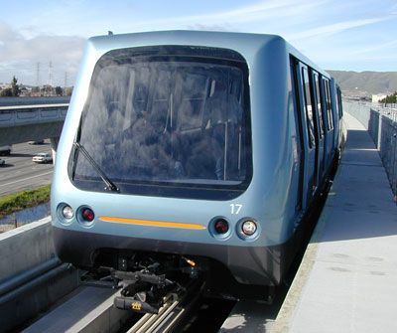
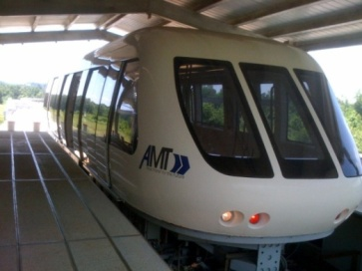
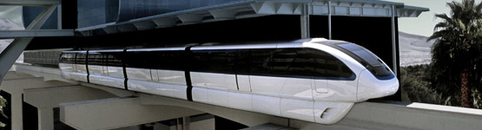
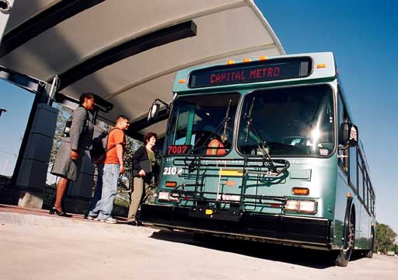
Alternatives/Technologies Under Review
No-Build Alternative
  Planned/Programmed Transportation Improvements by 2035
Transportation Systems Management Alternative
  Low-cost improvements
Build Alternatives
  Semi-exclusive lane Bus Rapid Transit alternative
  Elevated fixed-guideway; 3 potential automated guideway technologies

Slide 8
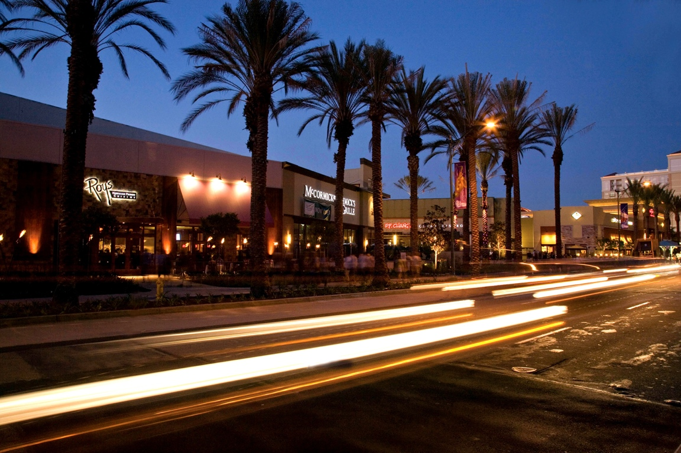
Cost and Funding Opportunities
ARC Capital Cost - $676 million
Public Funding Opportunities
Measure M – Project “S”
Federal Funding
State and local transit funds
Opportunities for Private Investment
Anaheim Design Build Operate Maintain Ballot Initiative
Anaheim Tourism Improvement District (ATID)
Operations and Maintenance - $10 million annual cost
Fully funded by local sources

Slide 9
Schedule
AA/Environmental Clearance/Conceptual Engineering
Preliminary Engineering Begins
Environmental Document Complete
Final Design/Construction
Construction Complete
UNDERWAY
2013
2014
2014 - 18
2018

